Slide 1

LONDON
Project Erasmus+ 6.08 – 17.08.2018
„A modern teacher – an aware European”

Slide 2
Anna Czerwik – the teacher of English and Katarzyna Flisiak – the teacher of mathematics at ZS Nr 2 took part in a two-week teacher training course in London from 6.08 to 17.08 2018. It was connected with their participation in the Erasmus+ project A modern teacher – an aware European.
A modern teacher.

Slide 3
Together with 7 other teachers of English from countries such as: Poland, Germany, Spain, Russia and Taiwan I participated in a methodology course for teachers. Its main aim was to teach and practice new methods of teaching, which I could use with my own students. Every day through workshops I got to know interesting ways for introducing variety on English lessons, for revising new vocabulary and practicing grammar skills. I had an opportunity to learn how to motivate students for self education, how to present the new material in an exciting way and how to develop certain language skills such as: writing, reading, listening and speaking.
My language school International House London was situated in the city center near the famous Covent Garden, from where I had an easy access to cultural life: musicals, museums or the typical English pubs and cafes. My tutor, Jo, was a very friendly teacher, full of passion therefore the lessons with her were a real pleasure. Every day my school organised extra afternoon activities such as: various cultural events – trips, contests with prizes and meetings with other students from all around the world. I was excited to take part in an event „International cuisine”, during which I could try exotic dishes and appetizers. Together with Kasia we went out for a Pub Quiz on Friday evening. Unfortunatelly, we didn’t win the main prize but still it was a great fun!
My host family came from Ireland. During these 2 weeks I had a great opportunity to see how an everyday life in England looks like and to live in a typical English terraced house.
The whole project and my stay in London was so exciting – I met new people from all around the world, I sightsaw many wonderful places and, most of all, I participated in a very inspiring and effective training course, which has increased my teaching skills as a foreign language teacher.
Taking part in the Erasmus+ project is an experience which I would suggest every teacher.
Anna Czerwik

Slide 4
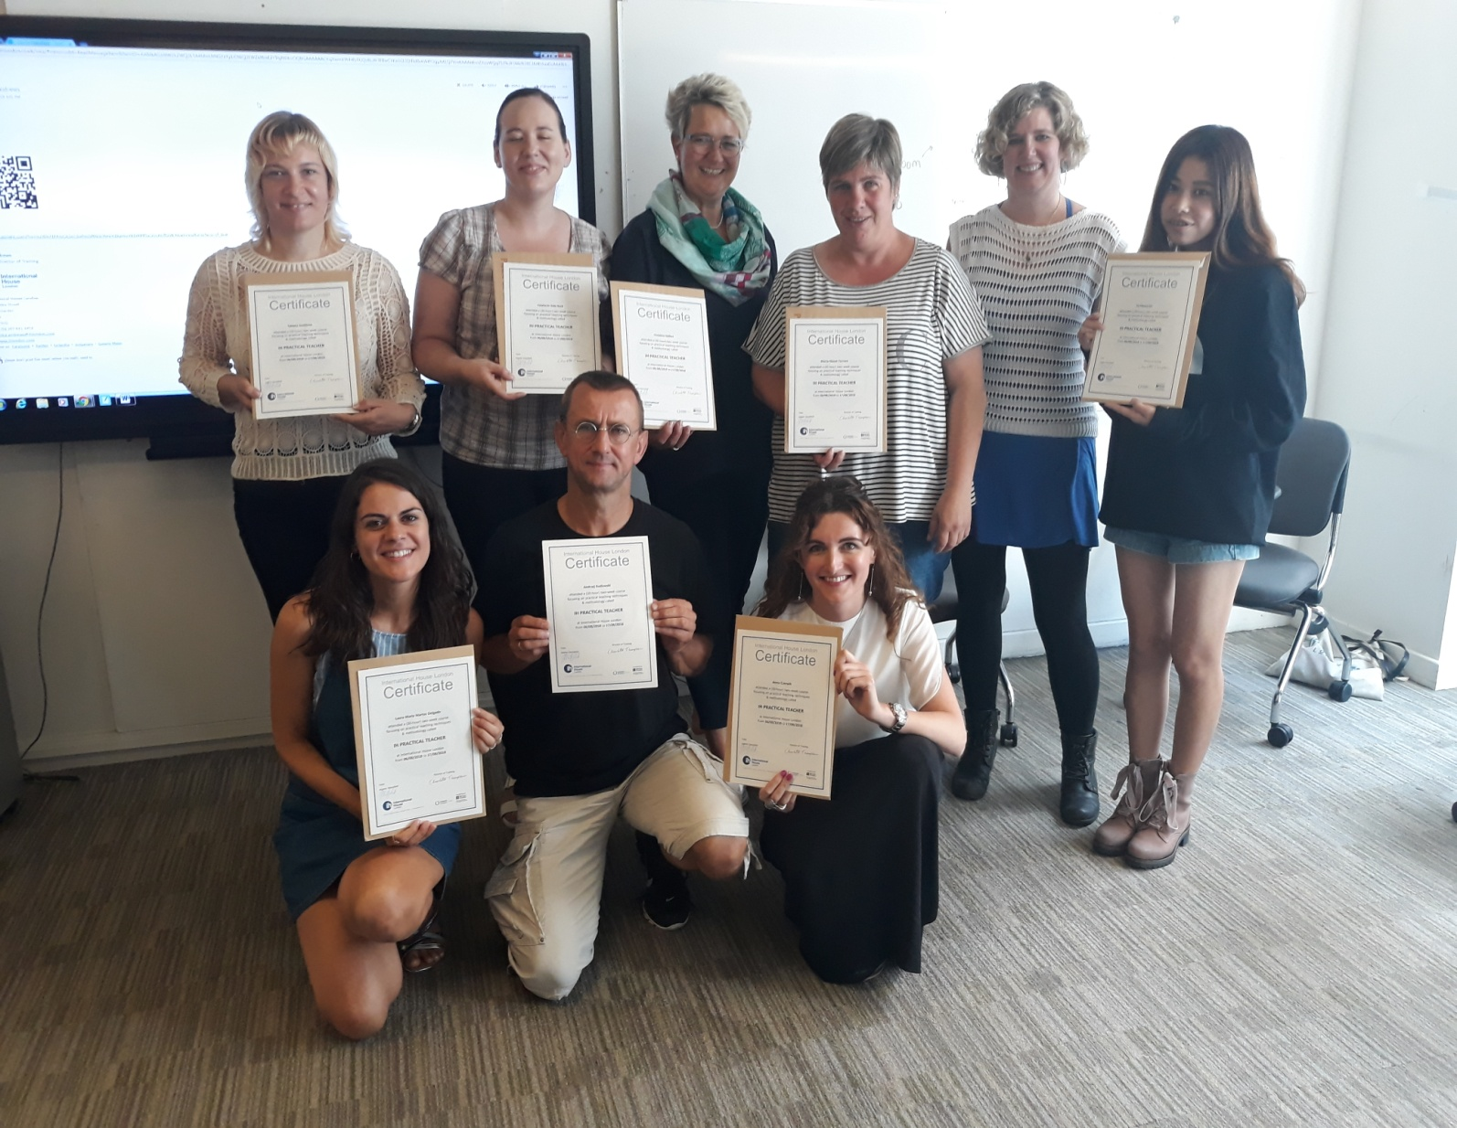

Slide 5
I participated in a standard language course Conversation at school LSI. The conversation lessons focused on learning new vocabulary from specific category e.g. nationalities, ecology, food. Between 8-10 students took part in the lessons, during which we had mainly groupwork activities. Our teacher introduced a topic and we discussed it in our groups (between 2 to 5 students). Next we spoke about it together as the whole class. The biggest advantage was the ooportunity to speak English the whole time. In my class there were people from Chile, Venezuela, Turkey, Saudi Arabia, Italy, South Korea, Tailand and Japan. There was no possibility to use another language. Most of the students were friendly and were keen on making new friendships. As an effect we spoke English all the time.
During these 2 weeks I was staying at an English family. My host family were very friendly so we met during the meals, twice a day and that gave me another opportunity to communicate in English.
To sum up, after the participation in this project I have become more self-assured in communicating in English and I believe that I can learn this language.
Katarzyna Flisiak

Slide 6
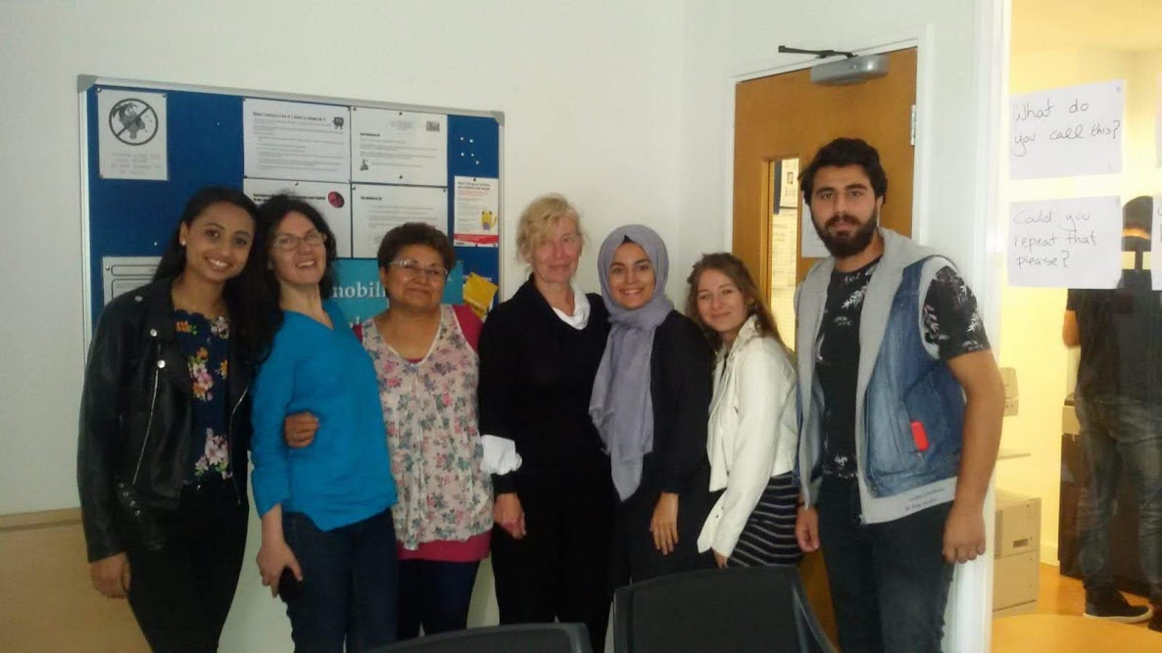

Slide 7
During the 2-week stay in London we not only improved our qualifications and communication skills. It was also a time for expanding our horizons – learning about new cultures, increasing our level of tolerance and becoming more open-minded.
An aware European.

Slide 8
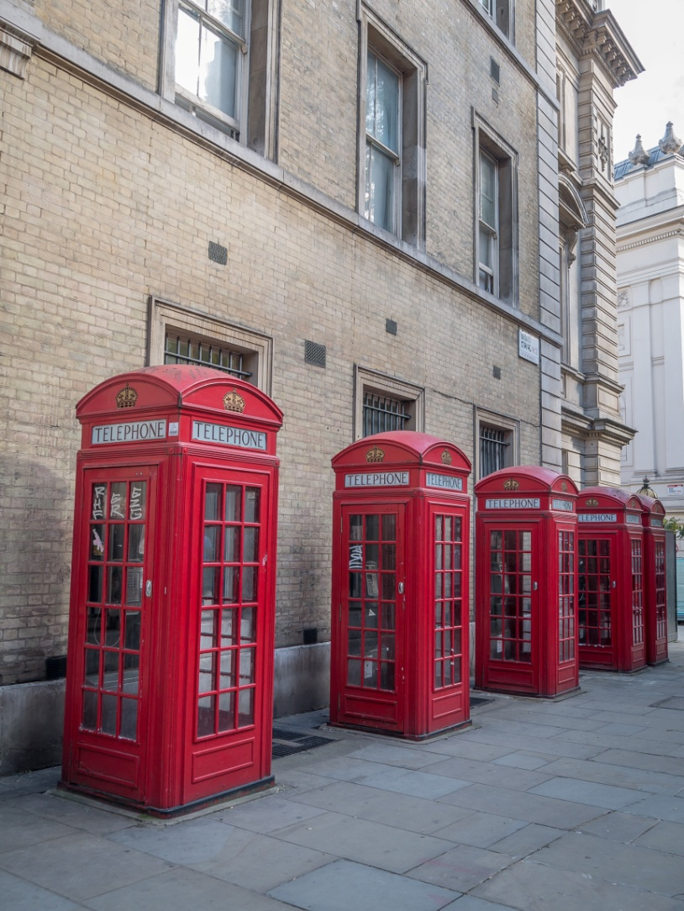
We learnt about the culture…

Slide 9
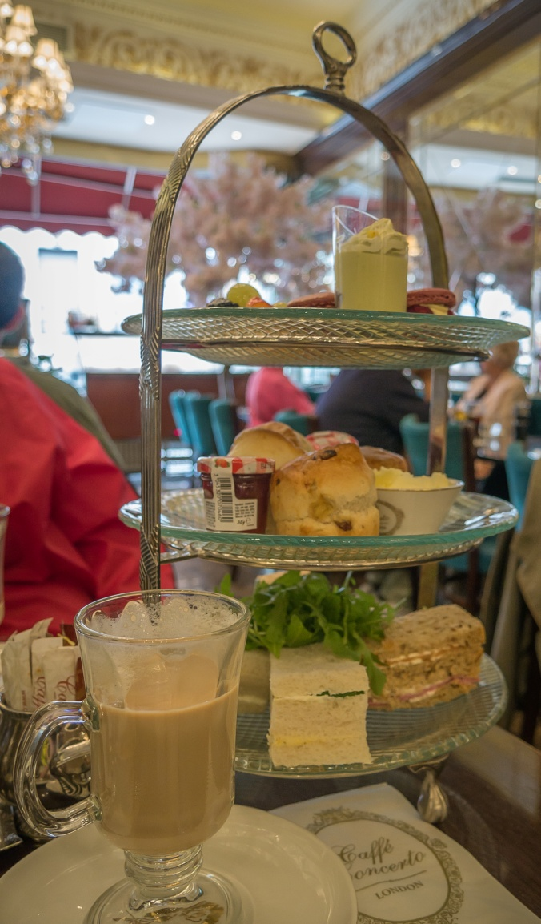
and English traditions.

Slide 10
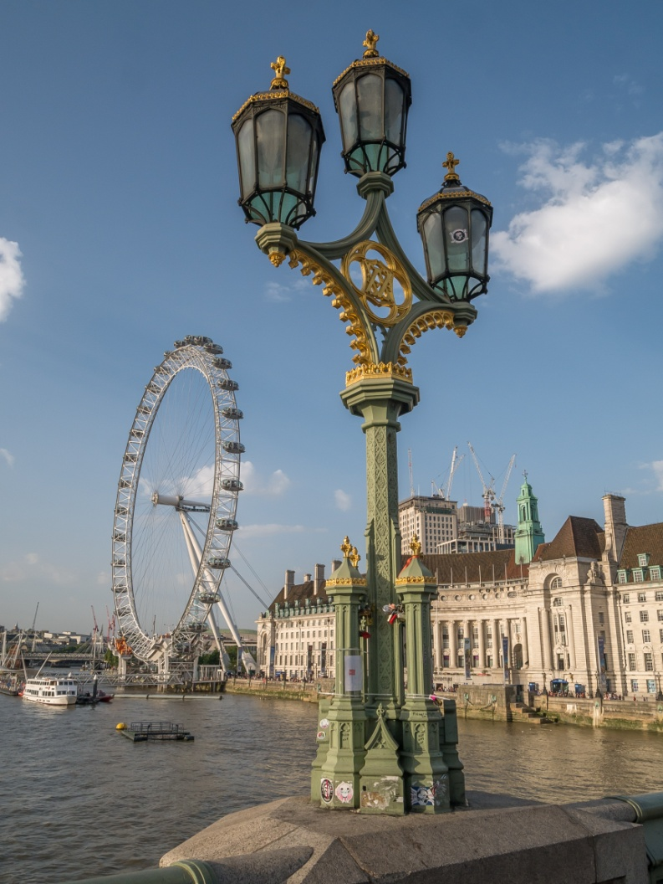
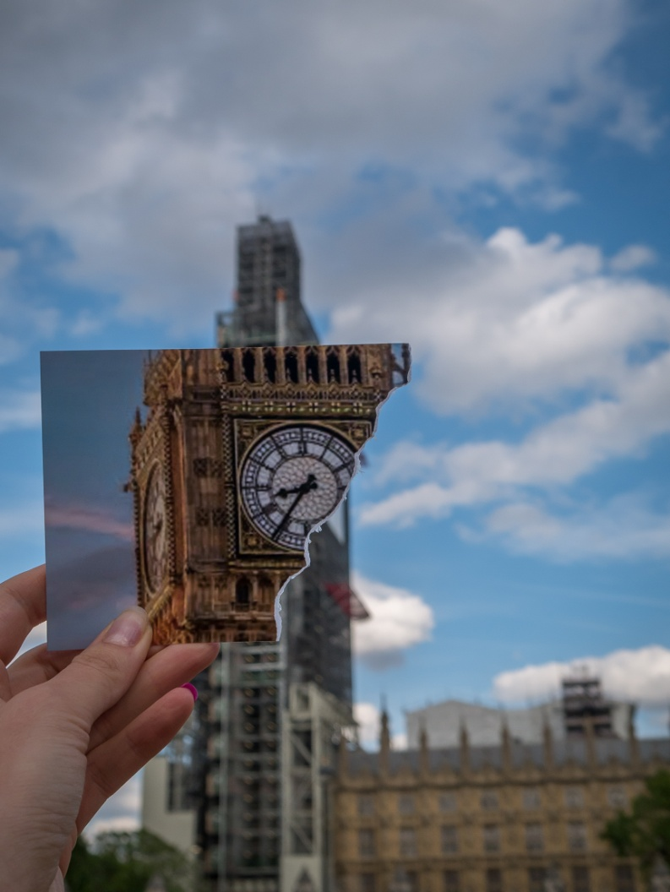
We admired the worldwide known monuments.

Slide 11
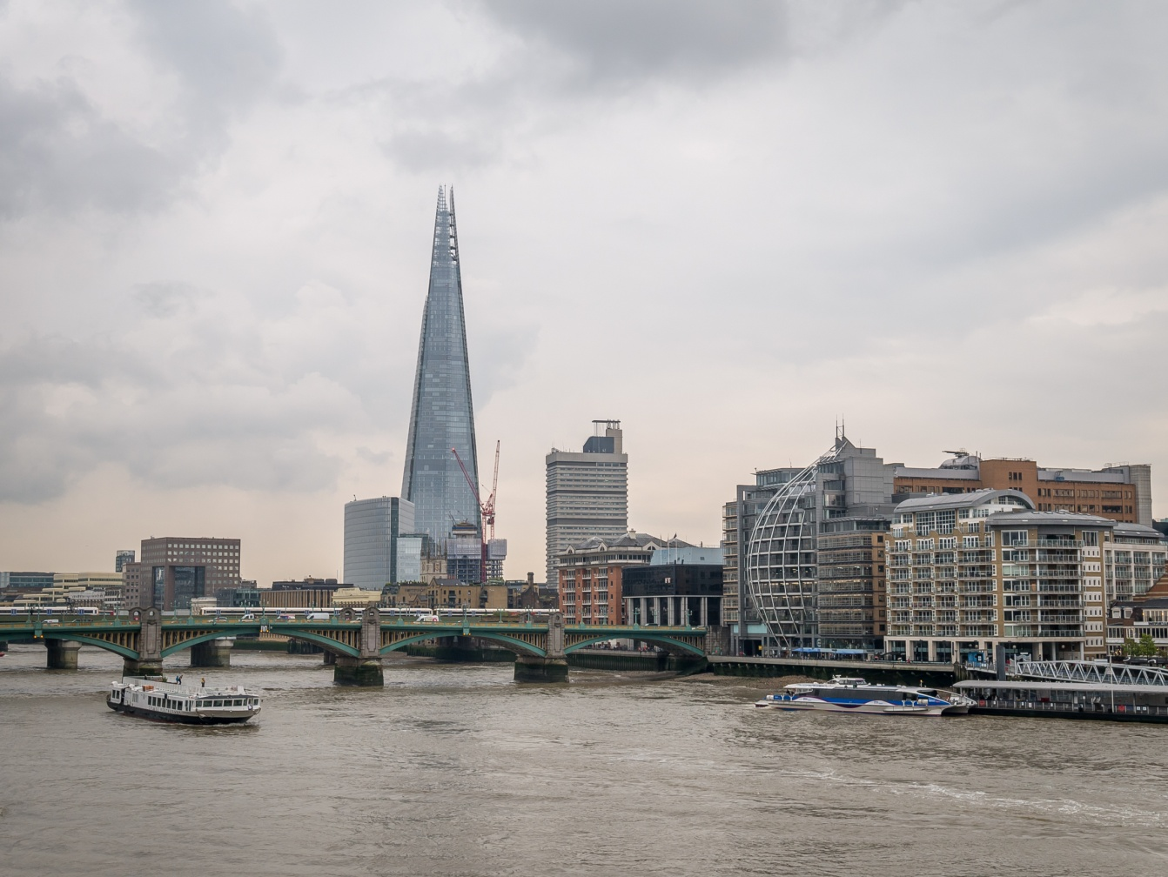
We understood the proverb
English weather.

Slide 12
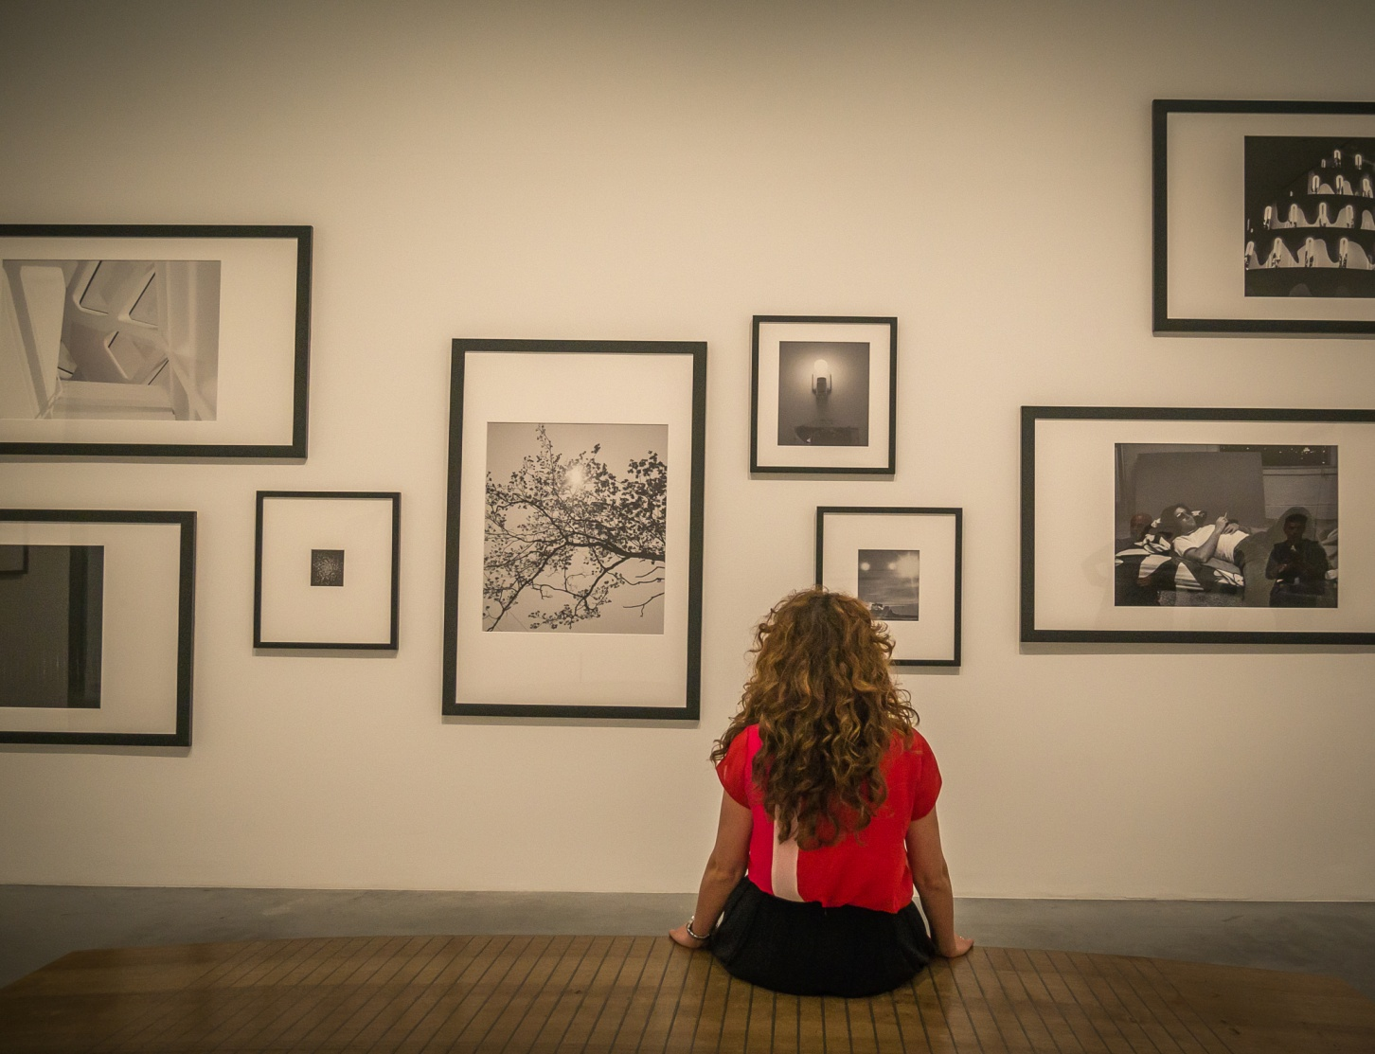
We visited the best galleries and museums in the world.

Slide 13
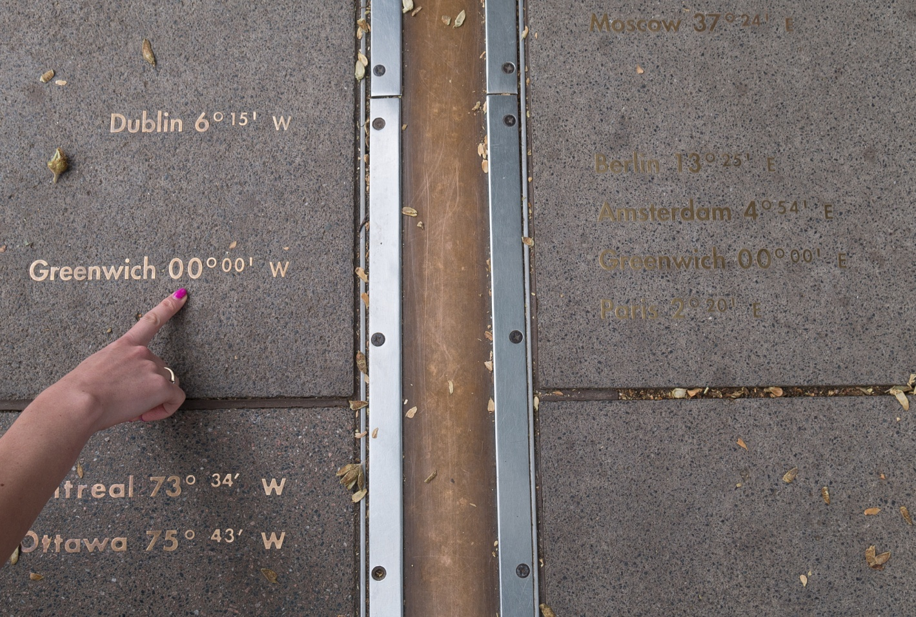
We were in incredible places, which will stay in our hearts forever.

Slide 14
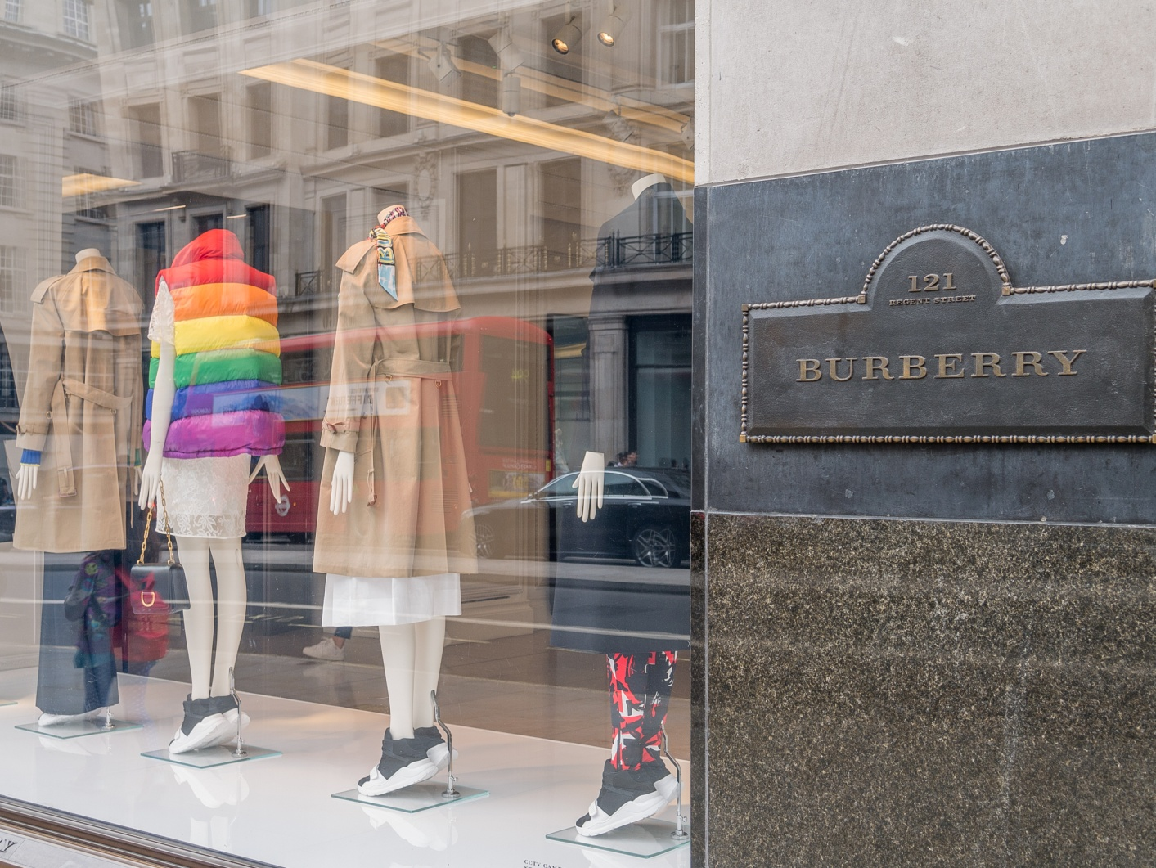
We had a contact with the big fashion…

Slide 15
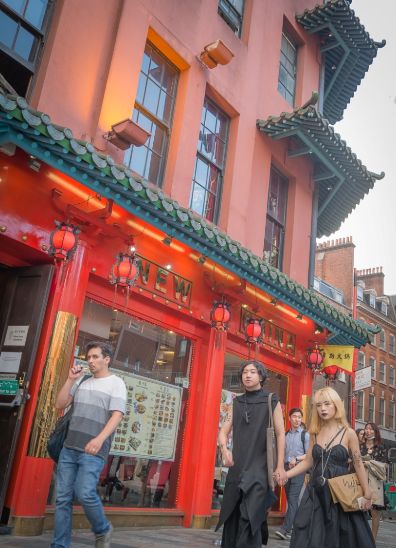
…although we didn’t like it each time ;)

Slide 16
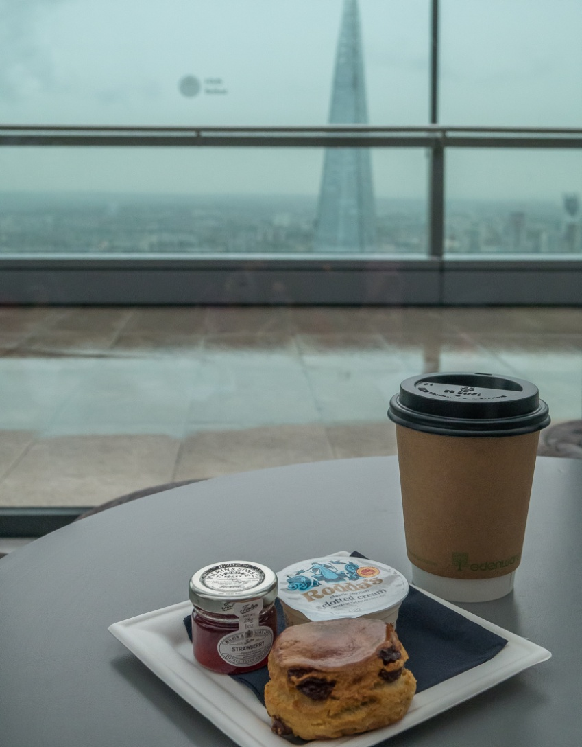
We drank delicious coffee from all around the world.

Slide 17
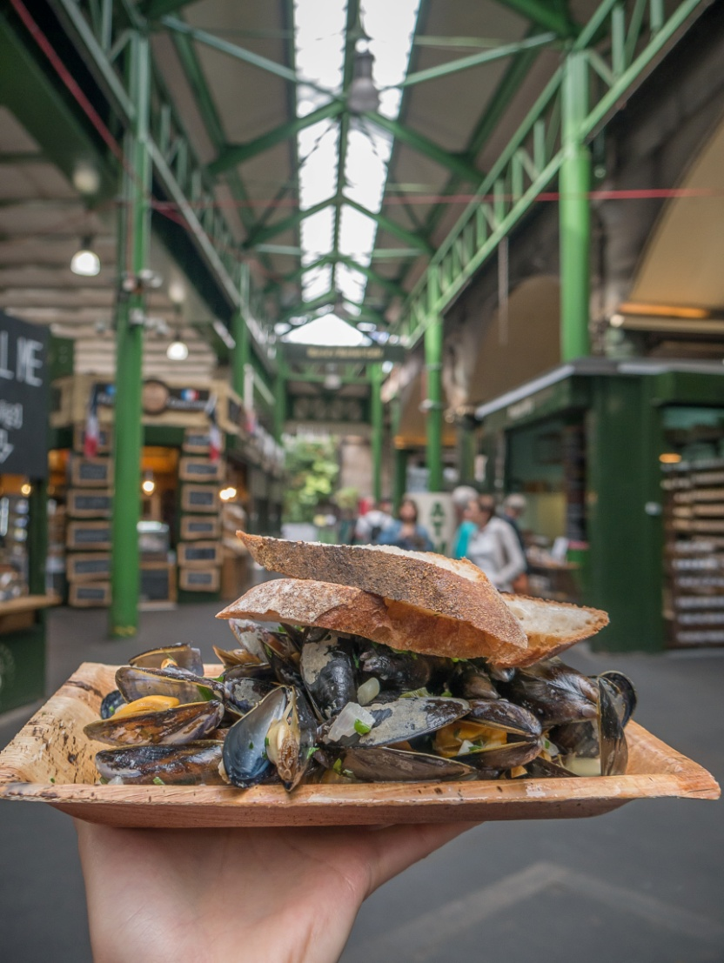
And we understood how varied food can be.

Slide 18
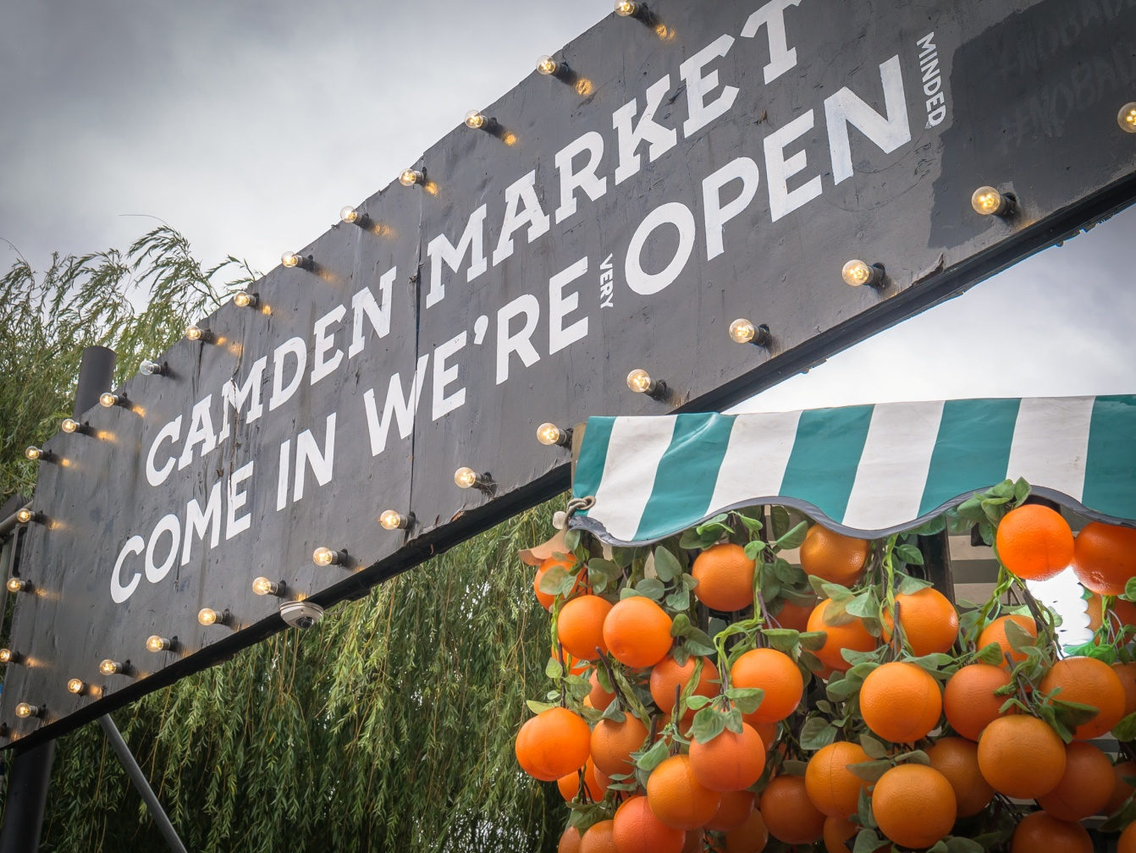
We also visited great markets.

Slide 19
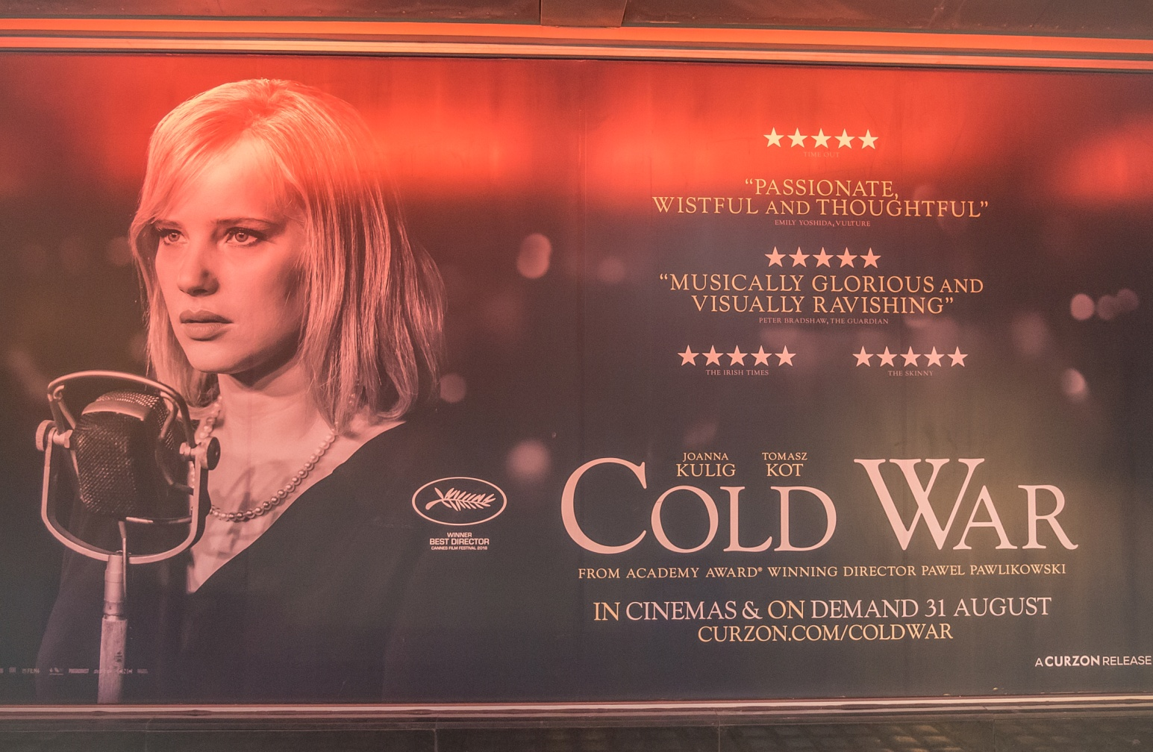
London proved to be a very modern and cosmopolitan city.

Slide 20
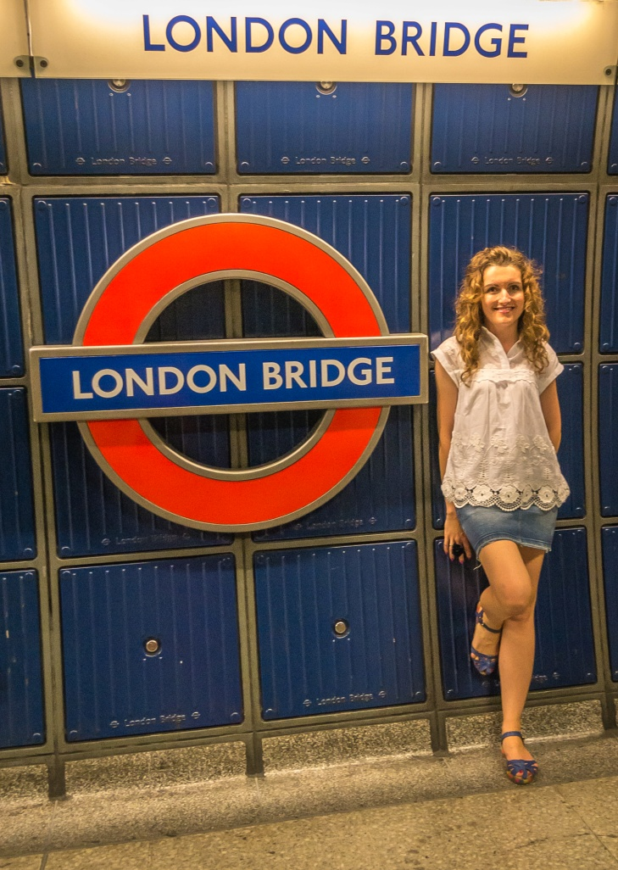
It also demanded from us learning new skills such as using the tube…

Slide 21
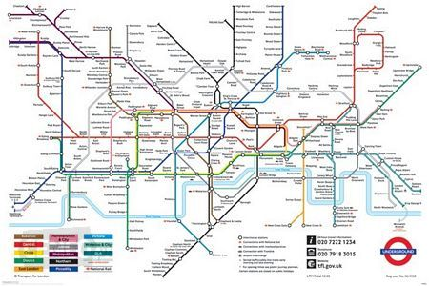
…which wasn’t that easy, especially at the beginning of our stay.

Slide 22
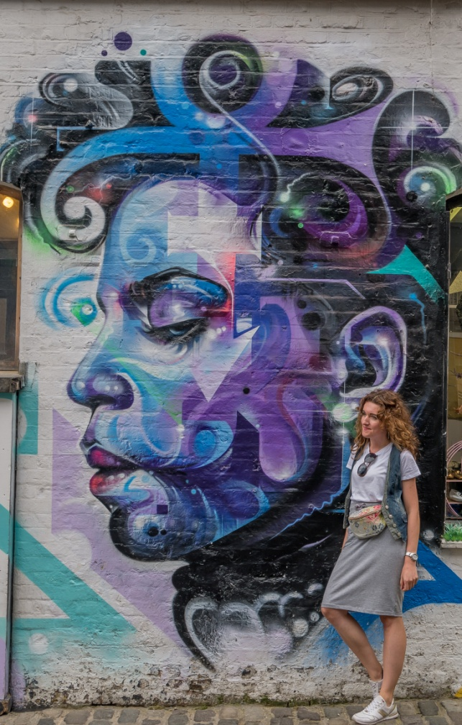
However it gave us the possibility to see inspiring places…

Slide 23
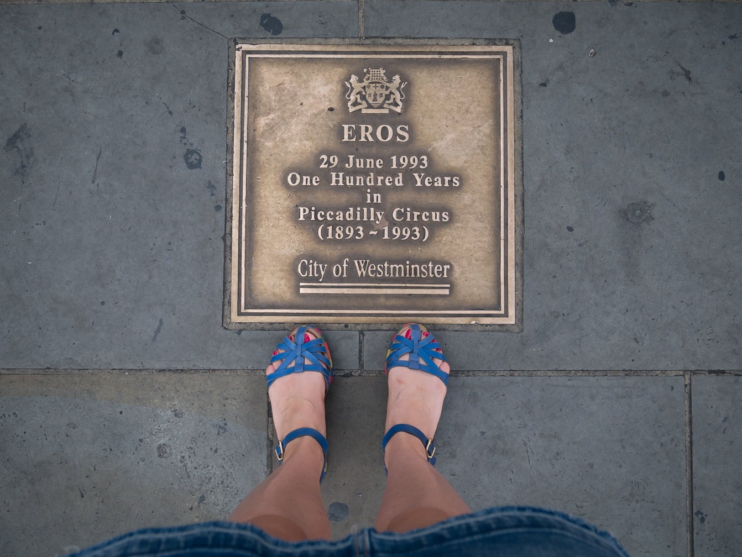
We expanded our history and art knowledge.

Slide 24
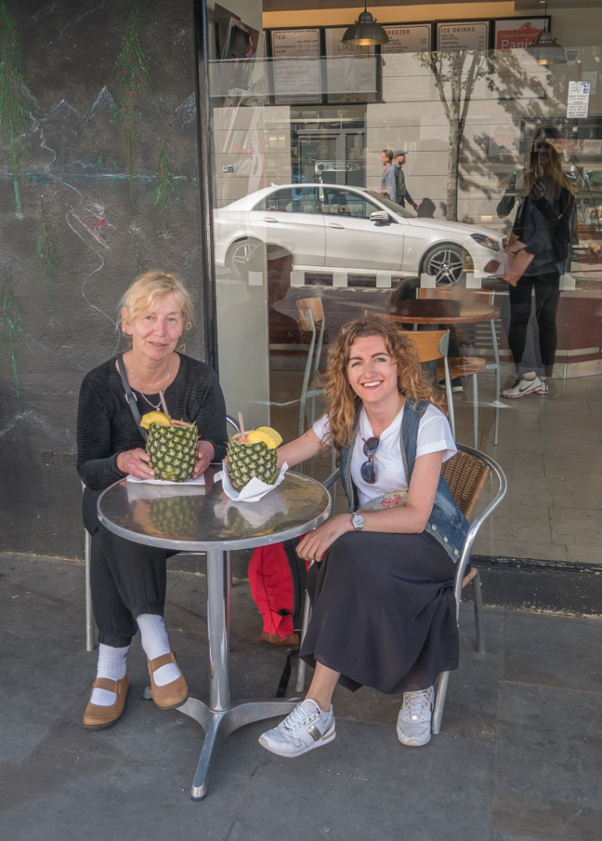
This was the adventure of our lives!
Ania and Kasia

Slide 25
Thank you
for your attention ☺

