Slide 1
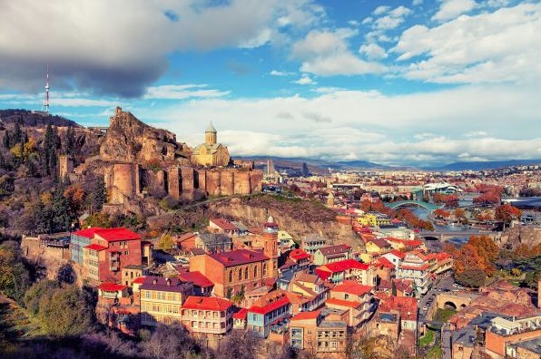
ARMENIA

Slide 2
Continent: Asia
Capital: Yerevan
Language: Armenian
Currency: dram
Population: 2,963,000 (2020)
Area: 29 743 km²

Slide 3
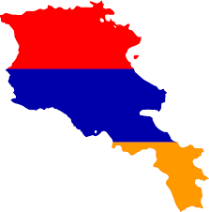
ARMENIA FLAG

Slide 4
FAMOUS PERSONALITIES

Slide 5
*Cher, or rather Cherylin Sarkissian, is a world-famous American singer and actress. She was born in 1946 in El Centro, California.
*Andre Agassi is a 44-year-old tennis player whose mother was an American and whose father was an ethnic Armenian
*Sergey Lavrov Russian minister of foreign affairs since 2004, previously he was the ambassador to the United Nations for a decade.

Slide 6
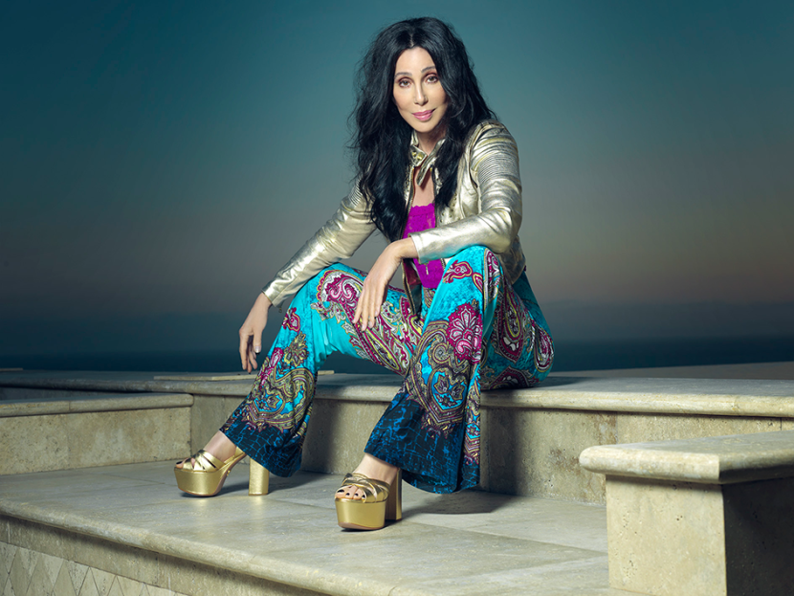
Cher

Slide 7
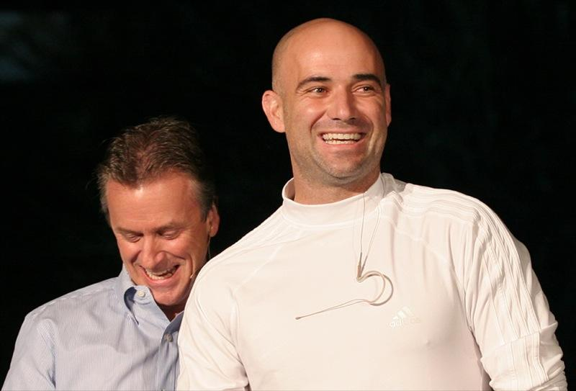
Andre Agassi

Slide 8
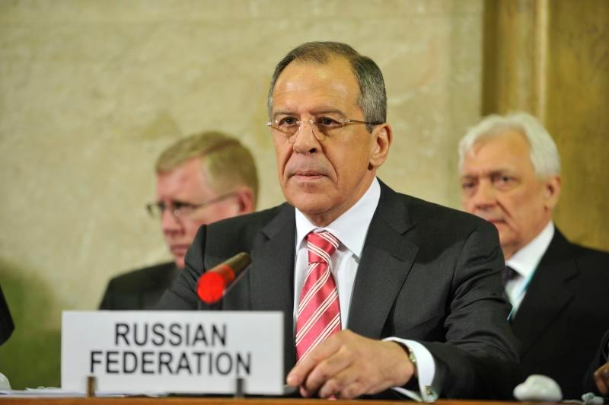
SIERGIEJ ŁAWROW

Slide 9
THE EUROPEAN CAPITAL CLIMATE
Yerevan is called the Paris of the East. It is a clean, tidy, very nice city, with lots of lovely eateries, cafes and restaurants. Over 1/3 of the country's population (1.2 million people) lives there. You can see and feel Western influences in the capital, which in my opinion adds to its charm.

Slide 10
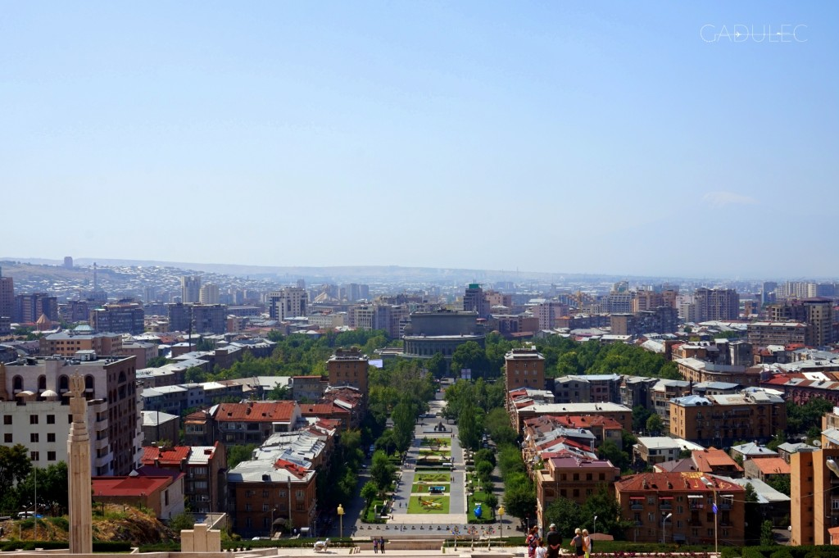

Slide 11
DELICIOUS FOOD AND COFFEE
Eggs (usually an omelette), specific cheese, jam and bread are eaten for breakfast. In addition, tasty coffee brewed in a traditional way (in Turkish), necessarily with a lot of sugar. In many restaurants, apart from Yerevan, coffee with milk is hard to come by. Grilled meat and potatoes are the most common meals for lunch and dinner. In summer, the eggplant and tomato dishes are delicious.

Slide 12
Legumes: chickpeas, lentils and beans are also a frequent ingredient of the dishes. With the meats, you can taste lamb, beef and poultry. In the form of additives, groats, especially bulgur, dominate. In Armenia, we will also taste the local bread: lavash bread.

Slide 13
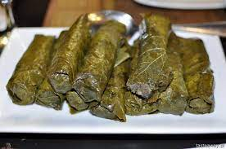
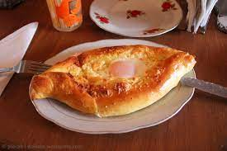
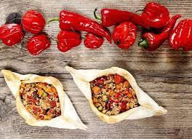

Slide 14
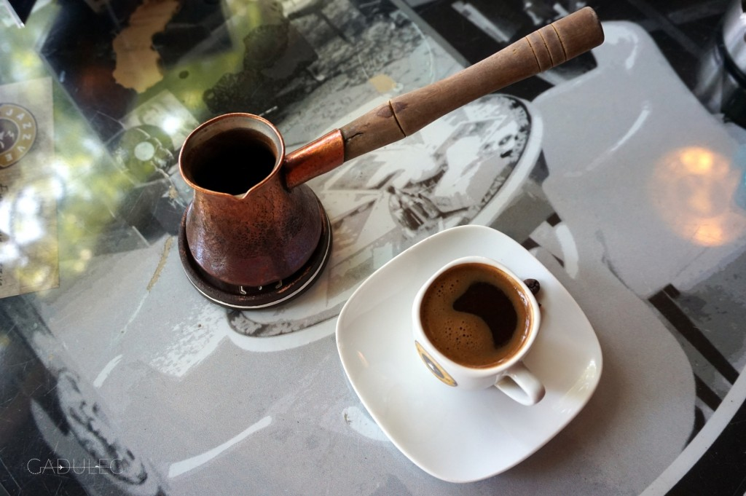

Slide 15
ALCOHOL
A famous Armenian product is sweet pomegranate wine. Armenia also specializes in the production of brandy and oghi fruit vodka (near the city of Goris, in the south of the country).

Slide 16
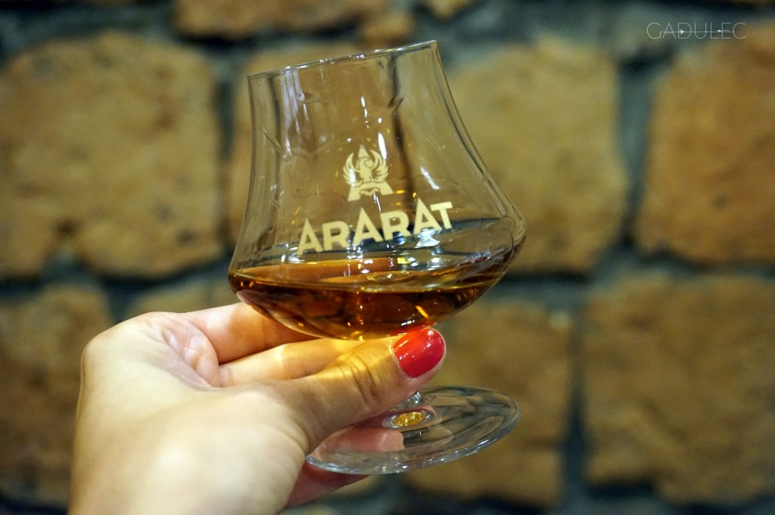

Slide 17
WEATHER
About 90% of the country is at an altitude of over 1,000 meters above sea level. This means that it is not very hot there at all! Yes, in Yerevan itself, temperatures as long as they reach 40 degrees Celsius, but even on Lake Sevan (which lies at 1900 m above sea level) it can be cold (for example, on the August night the thermometer showed 15 ° C).

Slide 18
RELIGION
Armenia is the first country in the world to adopt Christianity (already in the 3rd century CE). Most Armenians belong to the Armenian Apostolic Church. The seat of the bishop is in Eczmiadzzyn.

Slide 19
https://www.ecotravel.pl/oferta,126051733,gruzja,hotel,wycieczka-gruzja-i-armenia-2020.html
https://gadulec.me/ciekawostki-o-armenii/
https://poznajnieznane.pl/ciekawostki-2/ciekawostki-panstwa-3/armenia-ciekawostki/
https://www.tasteaway.pl/kuchnia-ormianska-czego-koniecznie-musicie-sprobowac/
https://www.polityka.pl/tygodnikpolityka/ludzieistyle/1617235,1,kim-sa-najbardziej-znani-ormianie.read

Slide 20
ALEKSANDRA ROSIŃSKA

