Slide 1
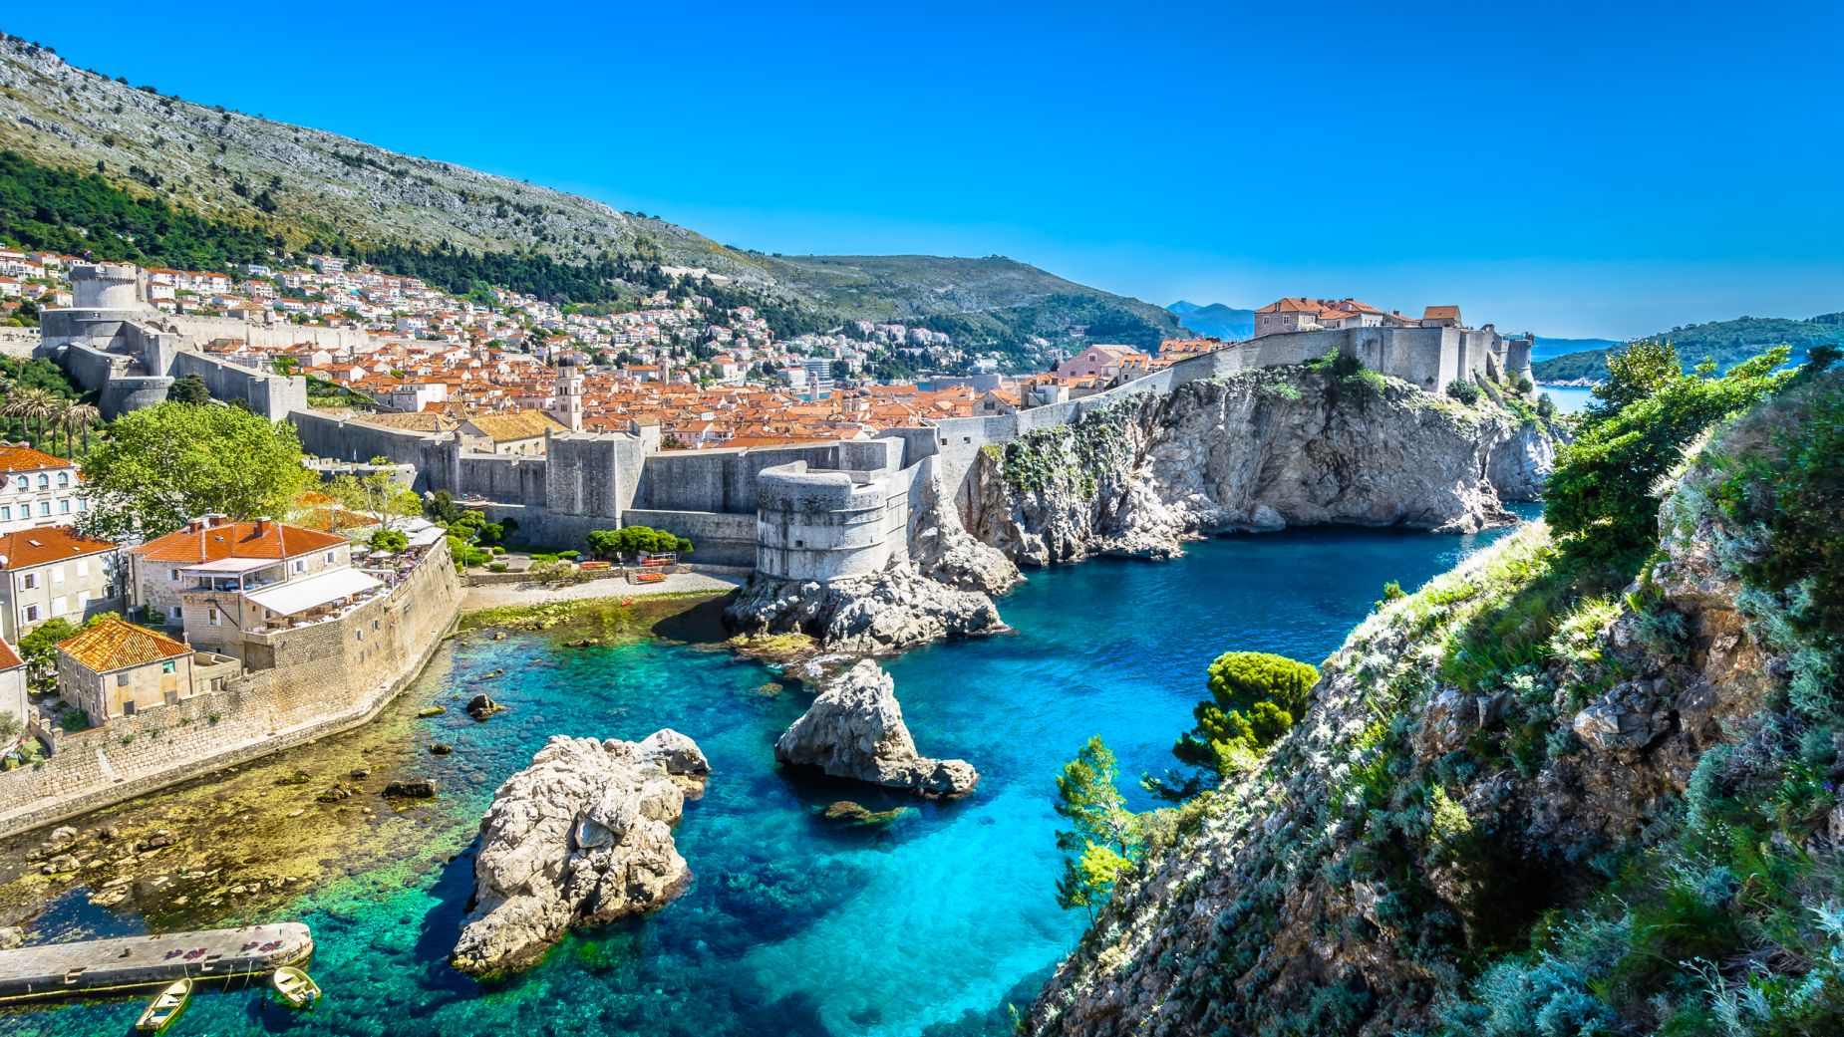
CROATIA

Slide 2
The currency of Croatia is the kuna and the capital city is Zagreb

Slide 3
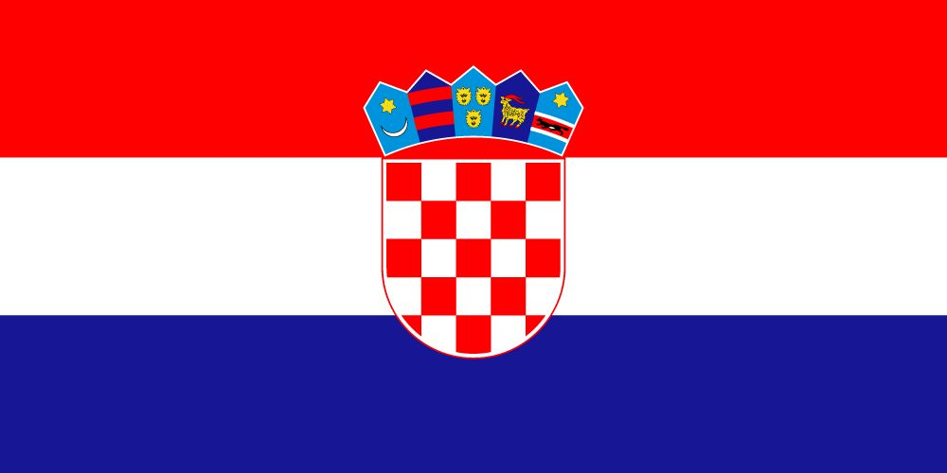
CROATIA FLAG

Slide 4
FAMOUS PERSONALITIES

Slide 5
*Marco Polo (1254 - 1324) - Venetian explorer and adventurer, he deserved the discovery of China for Europe. According to some historical sources, it comes from the island of Korcula.
*Nikola Tesla (1856 - 1943) - A physicist who operated in the USA, one of the greatest inventors in the field of electrical engineering. He designed the first AC power plant at Niagara Falls and developed the basics of radar devices. From his name comes the magnetic induction unit (Tesla - T).
*Ruđer Bošković (1711 - 1787) - One of the greatest Croatian scientists. The Dubrovnik philosopher, mathematician, physicist, astronomer, and worked in optics, mechanics, geodesy and construction technology.
*Slavoljub Penkala (1871 - 1922) - Inventor of the ballpoint pen and fountain pen and the first Croatian two-seater plane.
*Vladimir Prelog (1906 - 1998) - Croatian chemist who operated in Switzerland, received the Nobel Prize in Chemistry in 1975.
*Zlata Bartl (1920 - 2008) - Also known as Ciocia Vegeta, she developed the well-known brand Vegeta, which captured the markets of forty countries and became synonymous with the spice.

Slide 6
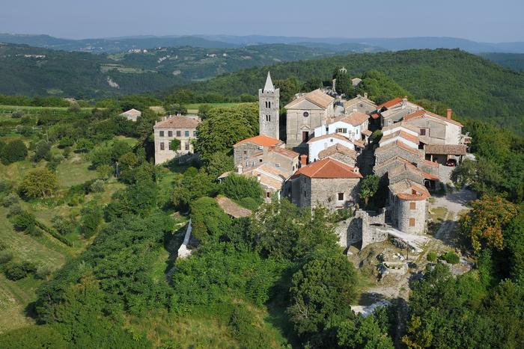
THE SMALLEST CITY IN THE WORLD

Slide 7
On Istria there is the smallest city in the world that has been entered in the Guinness Book of Records. It is called Hum and is inhabited by only 14 people.

Slide 8
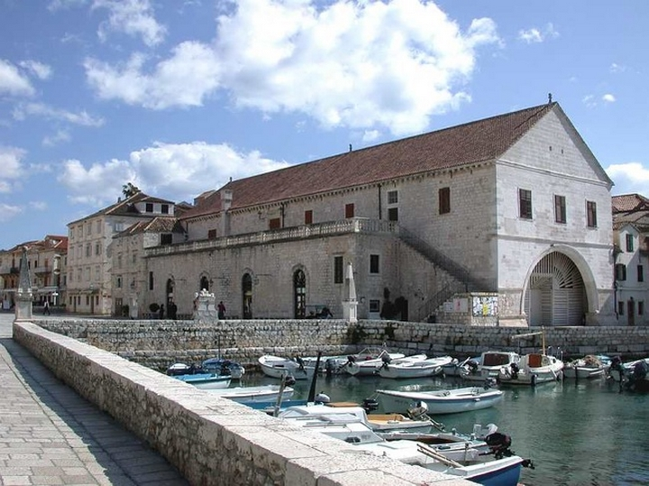
THE OLDEST THEATER

Slide 9
The oldest public theater in Europe is located in Hvar. It was built in 1612.

Slide 10
DIALECTS

Slide 11
It is also interesting that the inhabitants of a village in the north of Croatia called Bednja and the inhabitants of the Croatian island of Lastovo cannot communicate with each other due to the completely different varieties of Croatian dialects.

Slide 12
FOOD

Slide 13
When in Croatia, it is impossible not to try Croatian delicacies that are often found only in a given region. Most of them, however, can be found in any larger town. Probably each of you ate pizza while in Croatia. It is not a national dish, but nevertheless it found its way to Croatia very early, thanks to its Italian neighbors.

Slide 14
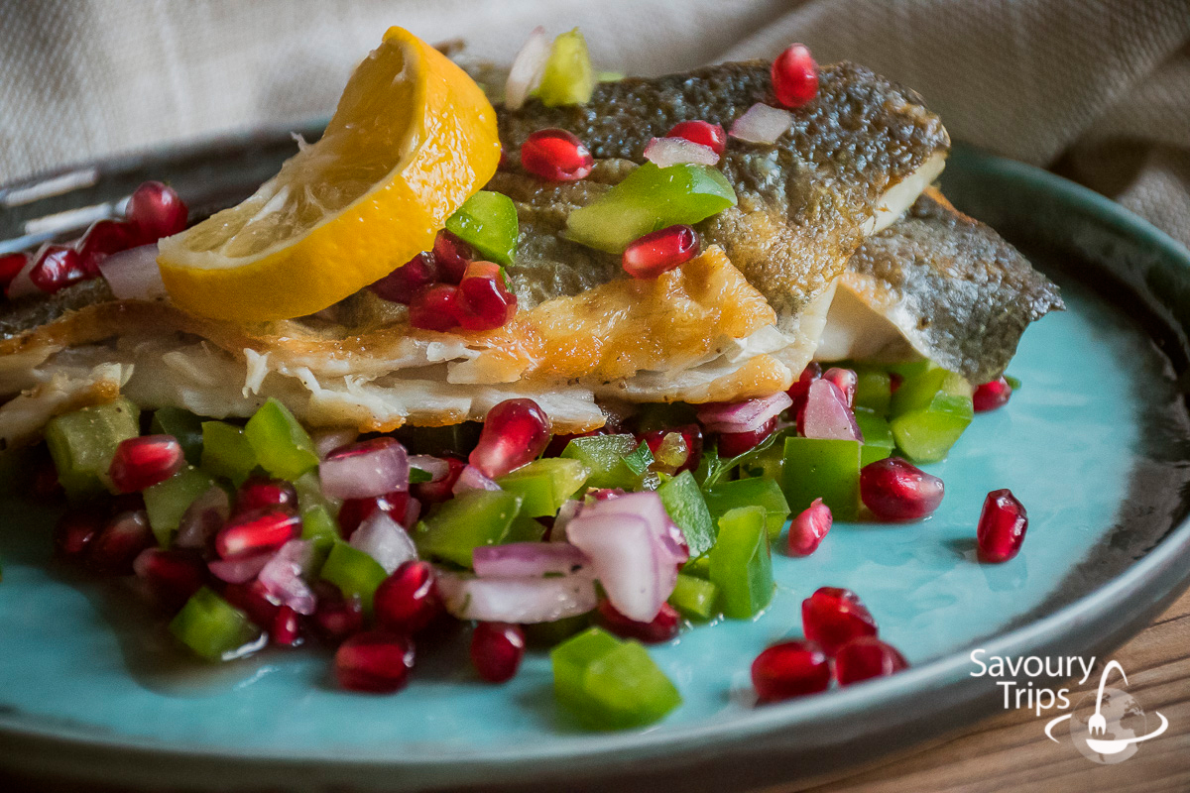
Grilled bream (Orada sa žara)
https://savourytrips.com/en/recipe-items/sea-bream-recipe/

Slide 15
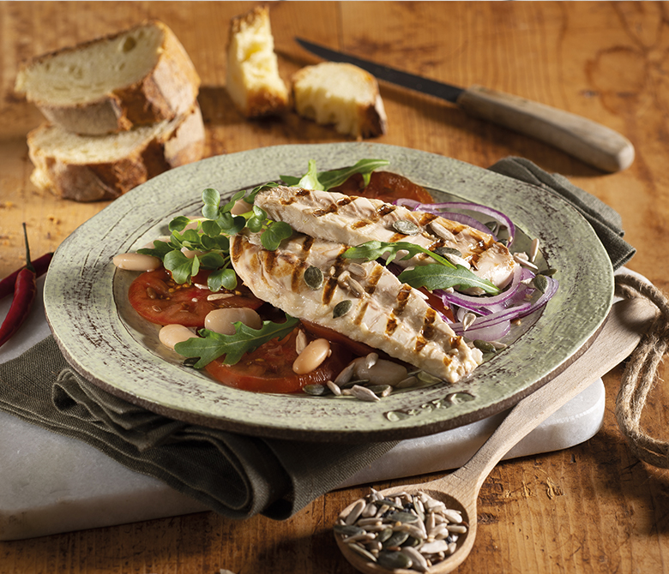
Grilled mackerel (Skuša sa žara)
http://www.riomare.hr/proizvod/fileti-skuse-sa-zara-u-vlastitom-soku/

Slide 16
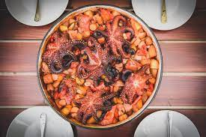
Seafood of various kinds
https://travel.earth/traditional-croatian-cuisine-to-try/

Slide 17
https://www.adriatic.hr/pl/blog/hum-najmniejsze-miasto-na-swiecie/328
https://www.adriatic.hr/pl/przewodnik/chorwacja-ogolnie-kultura-znani-chorwaci/155
https://sites.google.com/site/chorwacja542/home/ciekawostki
https://crolove.pl/10-potraw-ktore-musisz-sprobowac-bedac-w-chorwacji/
https://www.countryflags.com/product/croatia-flag-package/

Slide 18
ALEKSANDRA ROSIŃSKA

