Slide 1
France

Slide 2
Characteristic dishes of the French cuisine are:
onion soup with croutons,
Bouillabaisse soup (fish soup from Provencal cuisine),
shatobriand (double thick steaks),
Salad Nicoise,
Ratatouille (stewed vegetable dish),
Beef bourguignon,
Strasbourg pate (from goose liver),
Beans from Toulouse.

Slide 3
French famous people
Kylian Mbappe - football player.
Paul Pogba - footballer.
Antoine Griezmann - footballer.
Emma Watson - actress.
Pierre-Emerick Aubameyang - footballer.
Emmanuel Macron - politician.
Thierry Henry - coach, footballer.
Zinedine Zidane - football player.

Slide 4
Tourist attractions in France
Eiffel Tower
Louvre
Notre Dame Cathedral
Palace of Versailles
Triumphal arch

Slide 5
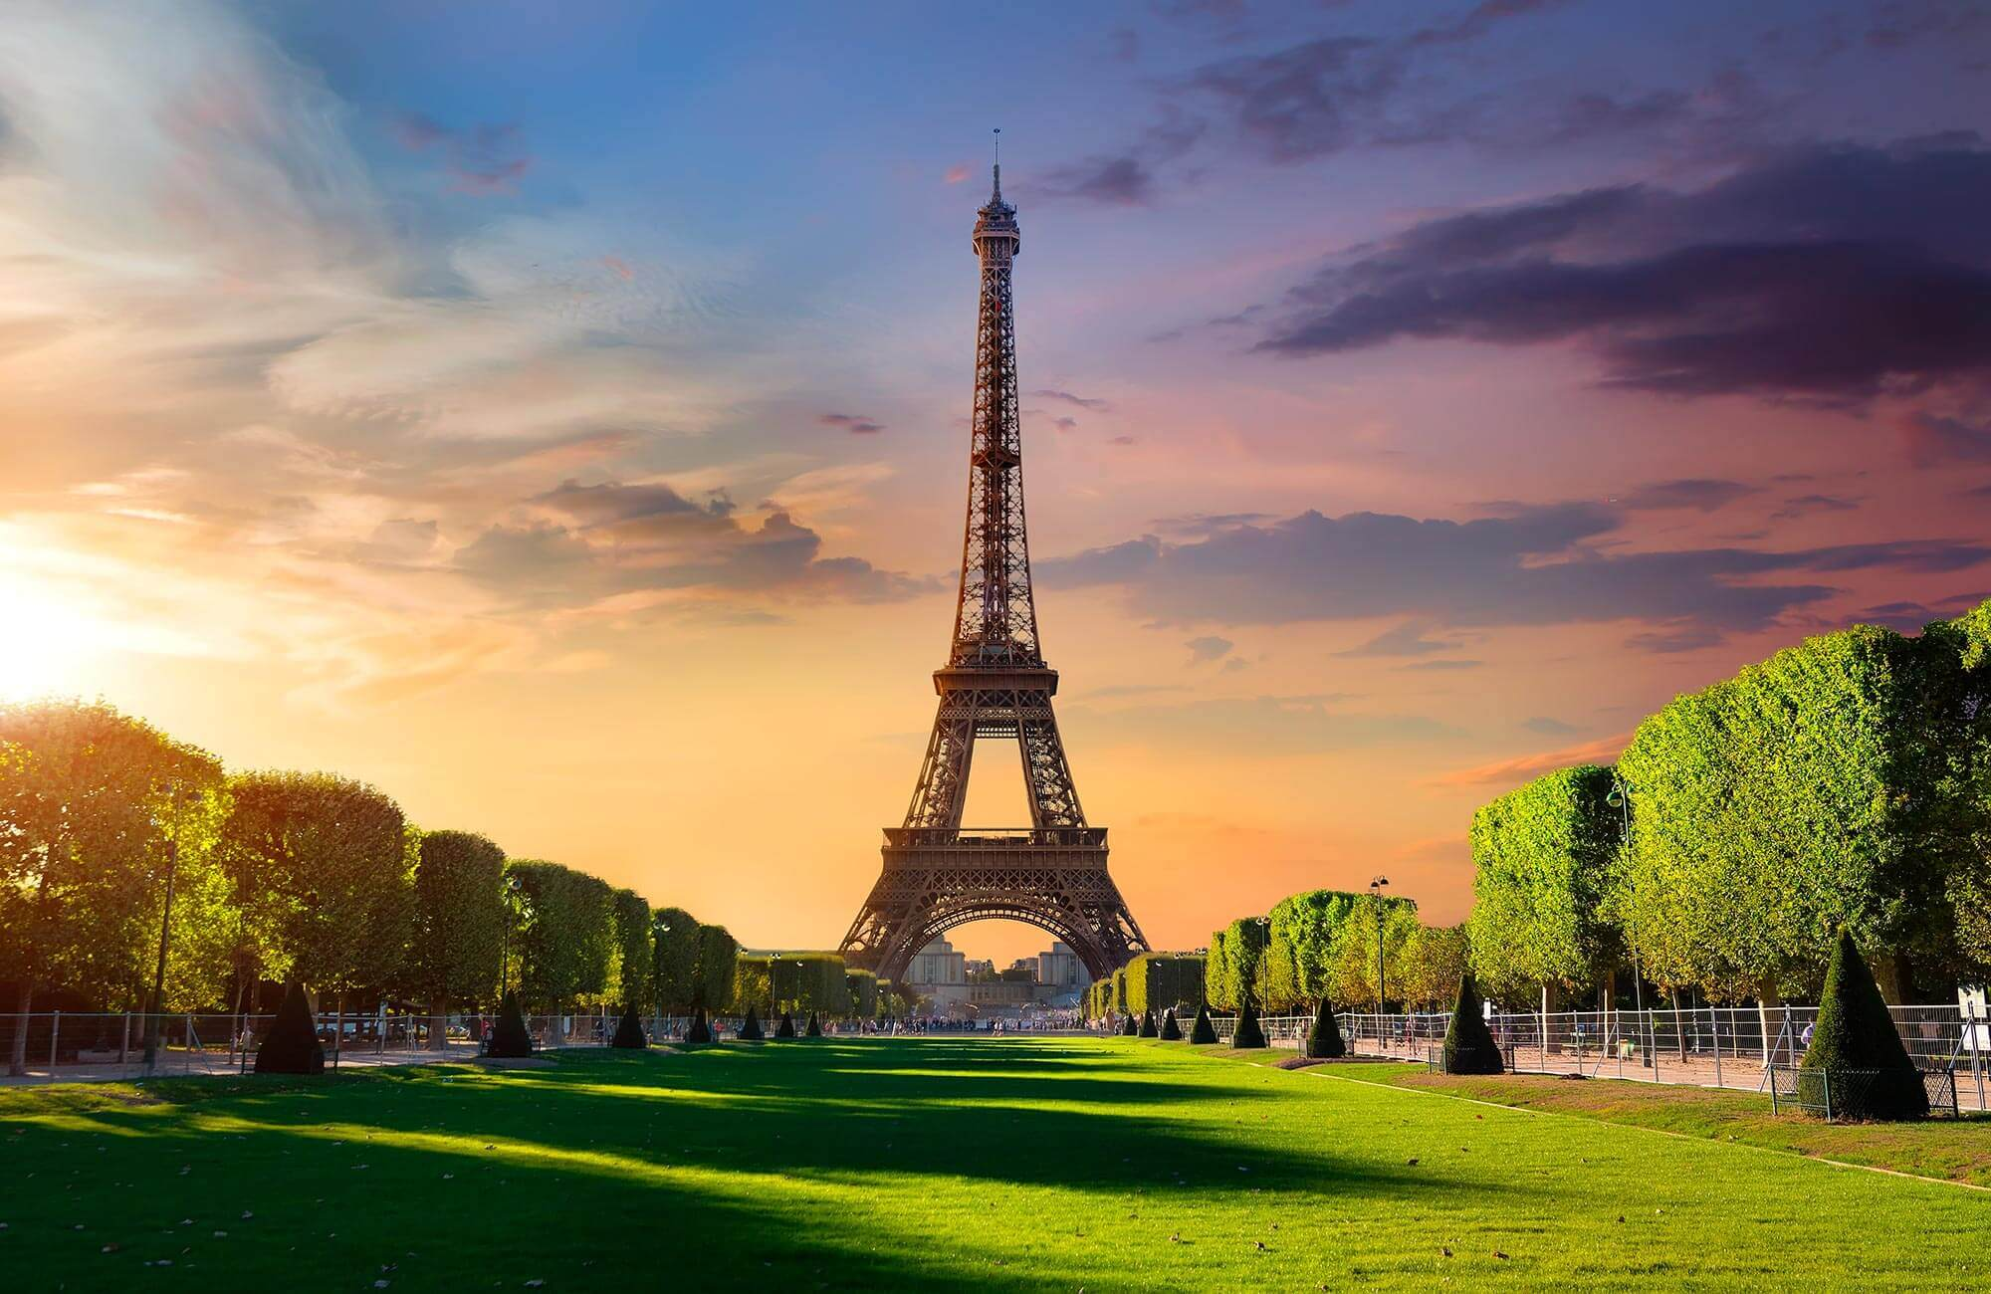
The Eiffel Tower

Slide 6
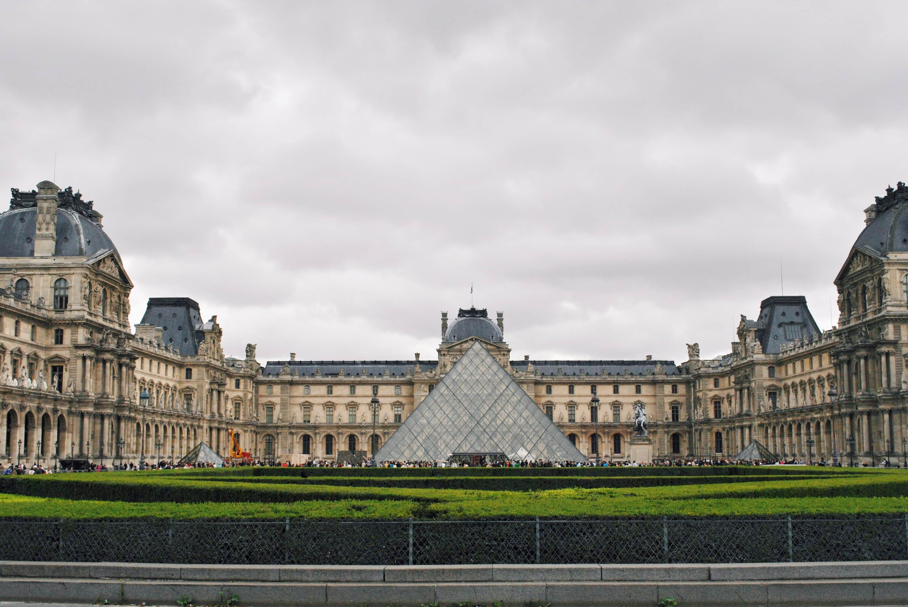
Louvre

Slide 7
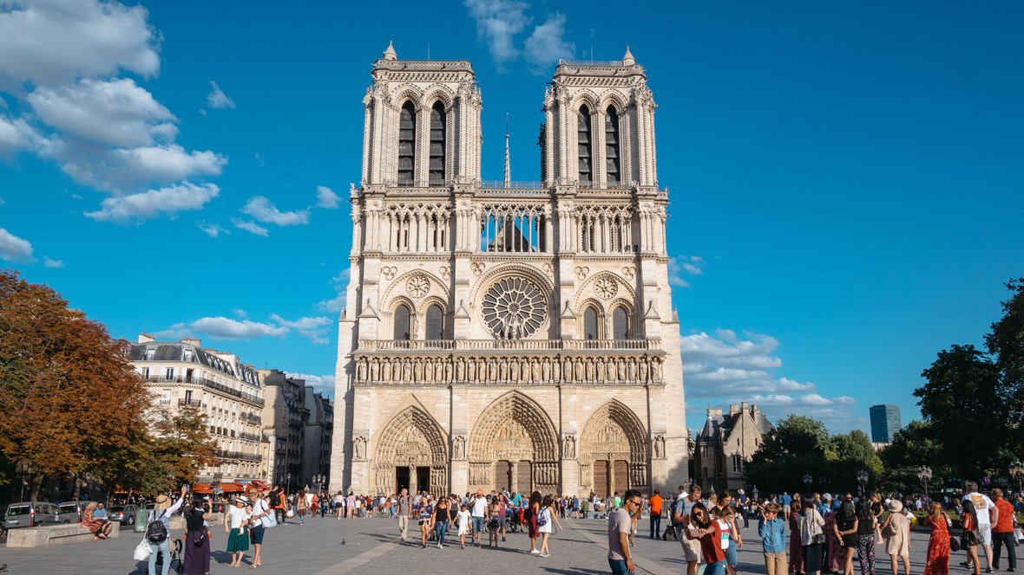
Notre Dame Cathedral

Slide 8
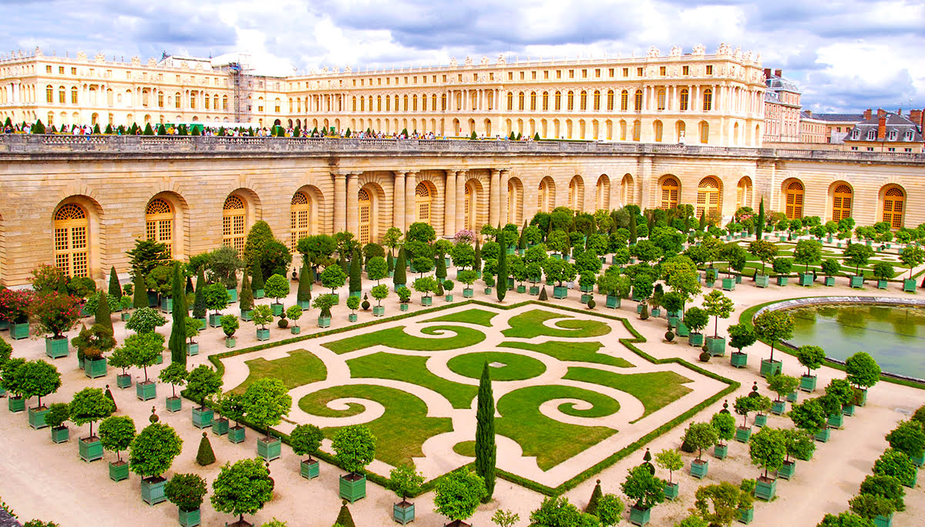
Palace of Versailles

Slide 9
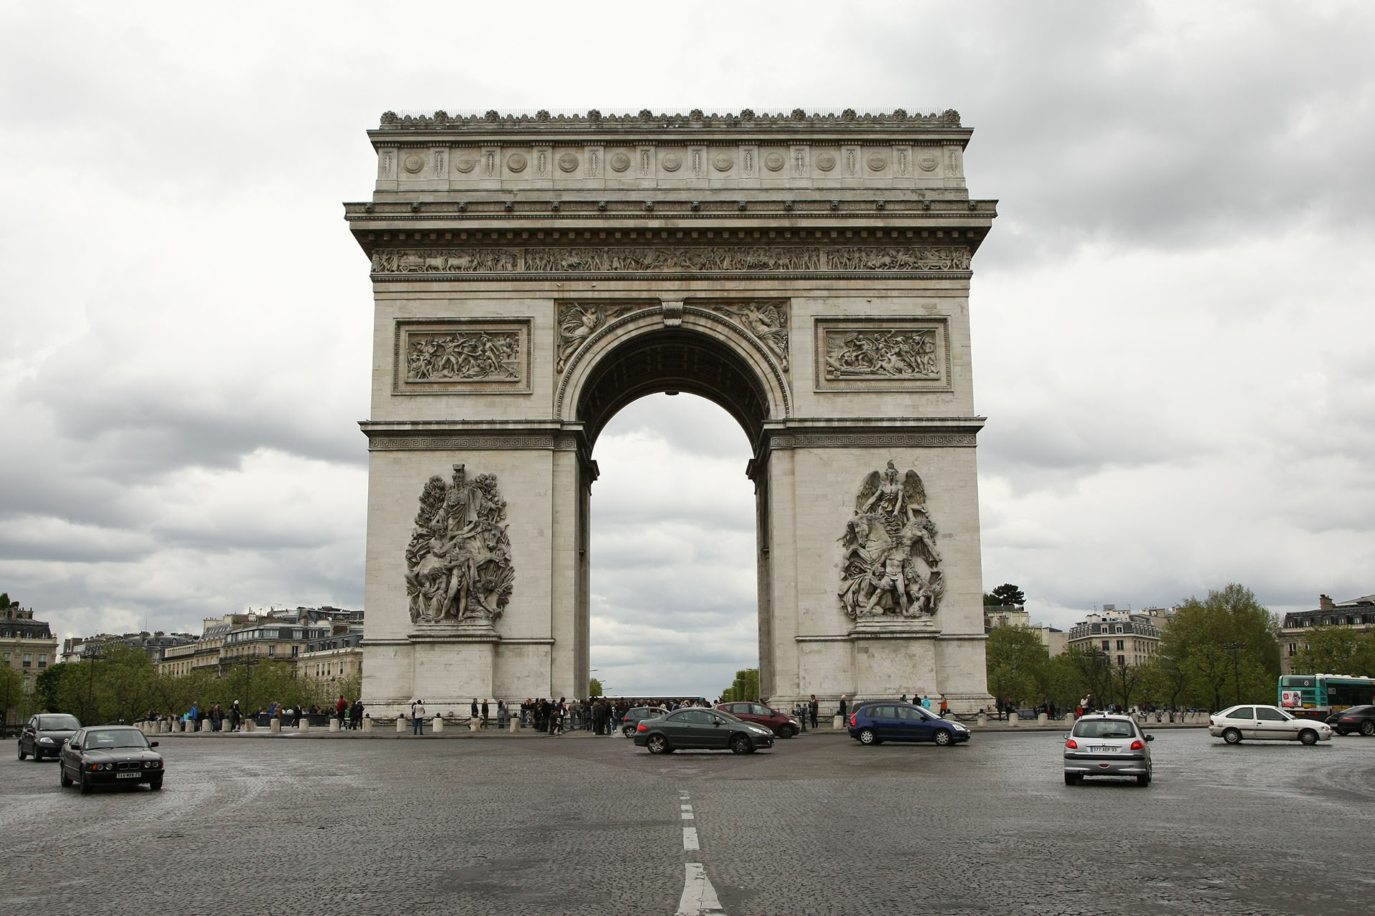
Triumphal arch

Slide 10
TOP 10 French songs of all time
„Ne me quitte pas” – Jacques Brel.
„Milord”- Edith Piaf.
„La bohème”- Charles Aznavour.
4.”Je t'aime, moi non plus”- Serge Gainsbourg.
„Je suis malade” Serge Lama.
„Comme d'habitude”- Claude François.
„Nathalie”- Gilbert Bécaud.
„Aux Champs Elysées” Joe Dassin.

