Slide 1

English Food

Slide 2
Meal Times
Breakfast- between 7:00 and 9:00 a.m.
Lunch- between 12:00 and 1:30 p.m
Afternoon tea- between 4:00 p.m. and 5.30 p.m.
Dinner- between 6:30 and 8:00

Slide 3
Breakfast
Consists of:
Scrambled eggs
Bacon
Sausages
Fried bread
Baked beans
Mushrooms
Called ‘’Full English” or ‘’The Full English Fry-up”

Slide 4
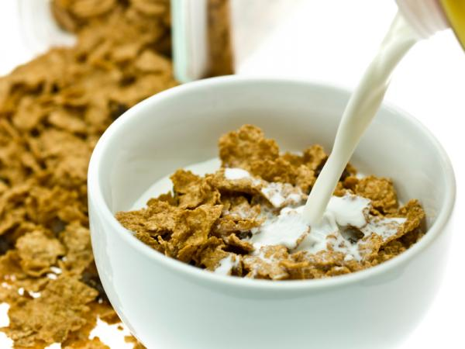
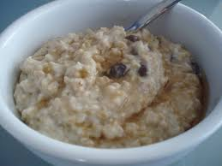
Breakfast II
Cereals with milk
Porridge
Toasts with jam

Slide 5
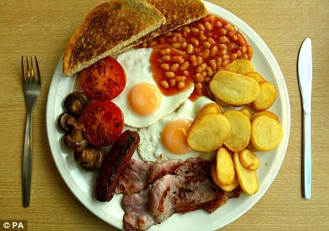
„The Full English Fry-up”

Slide 6
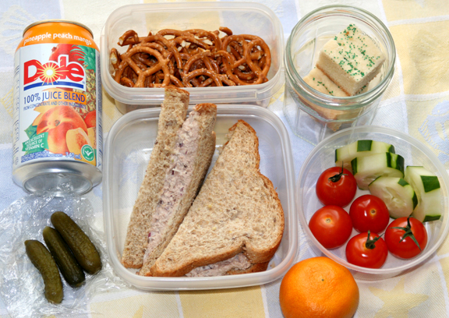
Lunch
(Packed Lunch)
Consists of:
Sandwich (butty or sarnie)
A packet of crisps
A piece of fruit
Drink

Slide 7
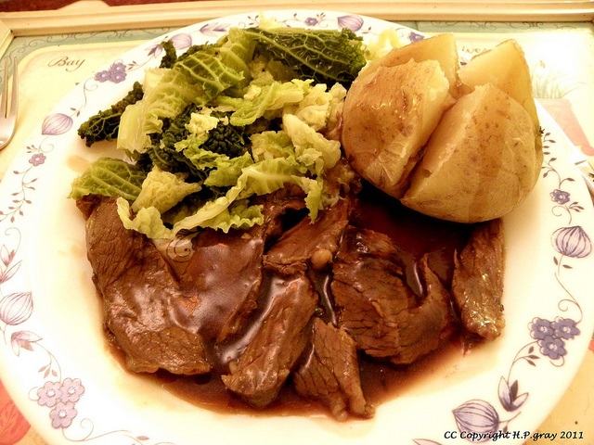
Dinner
(meat and two veg)
Gravy
Two vegatables (potatos)
Meat
Usually eaten on Sundays

Slide 8
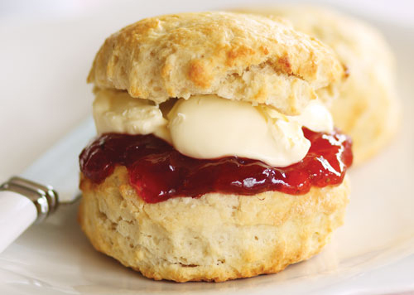
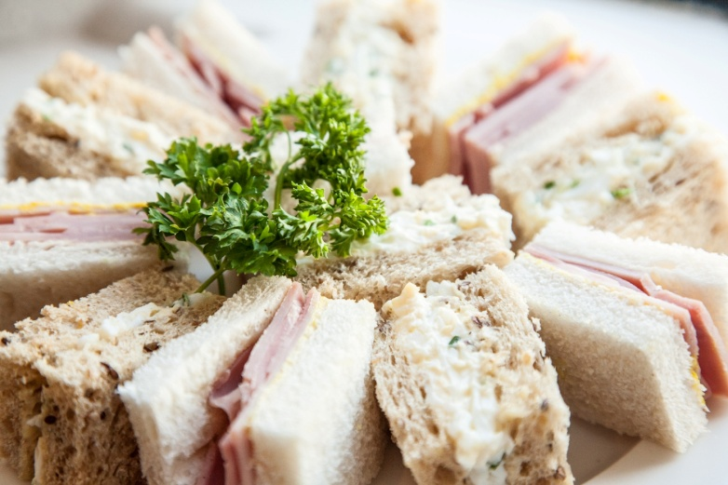
Tea
Consists of:
Black tea served with:
Freshly baked scones with cream and jam
Afternoon tea sandwiches

Slide 9
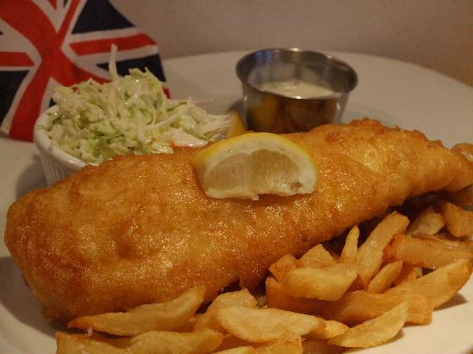
Typical dishes
Fish and chips

Slide 10
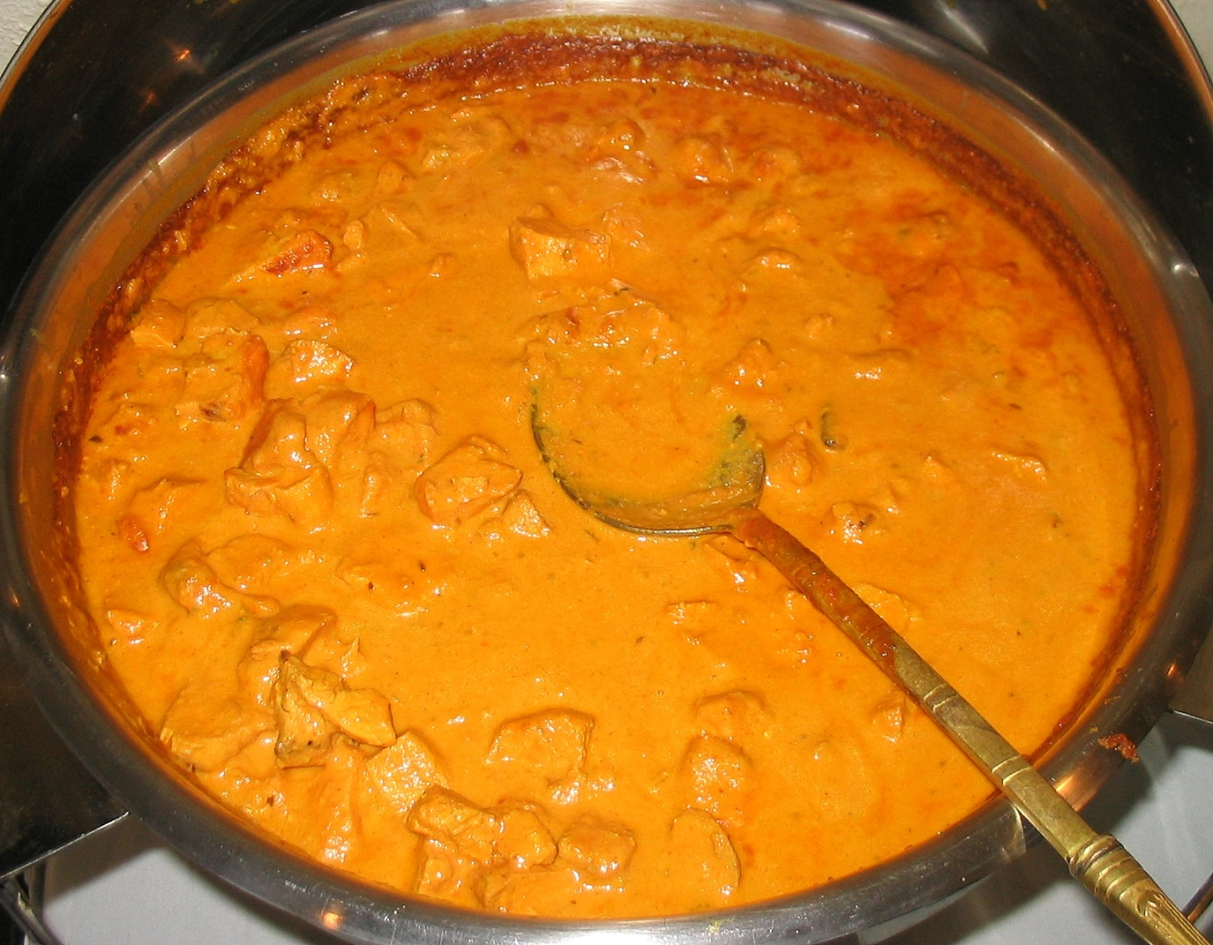
Chicken Tikka Masala

Slide 11
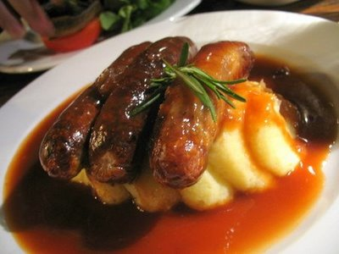
Bangers and mash

Slide 12
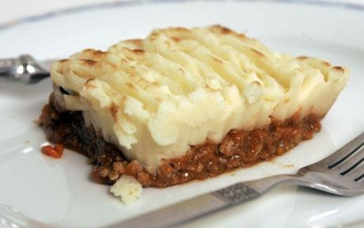
Shephred’s Pie

